Slide 1
Introduction to Data Science
California State University Long Beach
Damien Benveniste

Slide 2
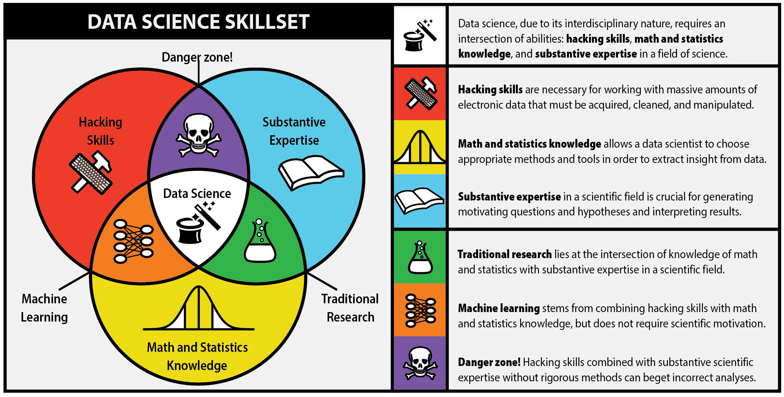

Slide 3
Jobs in Data Science

Slide 4
Jobs in Data Science

Slide 5
What is this class about
Python
Data manipulation
Statistics
Machine Learning
What is this class is NOT about
Other relevant programming languages
Database systems
Distributed big data tools

Slide 6
Logistic
6 Homework (60 %)
Mostly programming problems
2 Midterms (20 %)
Mostly analytical problems.
1 Final project (20 %)
You choose some data, extract information from it and write an article-like report
Kaggle competition (10 % bonus)
Grade depending on your ranking
A+ if you rank 1st!

Slide 7
Important tools for the class
Piazza
Website
Github
Anaconda
Main IDE for the class: Jupyter
Other possible IDE for data science: Spyder, PyCharm, Zeppelin

Slide 8
Optional but classic books
Tom Mitchell: Machine learning
Christopher M. Bishop: Pattern Recognition and Machine Learning
H, T, F: The Elements of Statistical Learning

